Slide 1
KAPPA DELTA PHI
Κ Δ Φ
Epsilon Chapter

Slide 2
WHAT IS A FRATERNITY?
Goes back to the beginning of time
Lodges & clubs for men since knights of old to the modern military and political men.
Facilitates fellowship of men of a common cause
Now allows many networking opportunities, connecting you to meet many people
Men gather together and become a brotherhood

Slide 3
FRATERNITY FACTS

Slide 4
FRATERNITY FACTS

Slide 5
FRATERNITY FACTS

Slide 6
FRATERNITY FACTS

Slide 7
FRATERNITY FACTS

Slide 8
FRATERNITY FACTS

Slide 9
FRATERNITY FACTS

Slide 10
FRATERNITY FACTS

Slide 11
FRATERNITY FACTS

Slide 12
FRATERNITY FACTS

Slide 13
KAPPA DELTA PHI our mission
The purposes of this fraternity shall be:
to bring together males of good character who are studying in institutions of higher education and who manifest a keen interest in higher education
to promote the highest ideals and educational practices
to promote a spirit of good citizenship and to seek change in our institution only through duly constituted authority
to actively support the fight against discrimination on the basis of race, color, or creed
and to strengthen and preserve the bonds of brotherhood which link men together working toward a common cause.

Slide 14
KAPPA DELTA PHI
Founded in 1900 at Bridgewater State College by Nahum Leonard
Has grown to encompass 33 campuses
Seek to strengthen bonds of brotherhood and seek truths in our professions

Slide 16
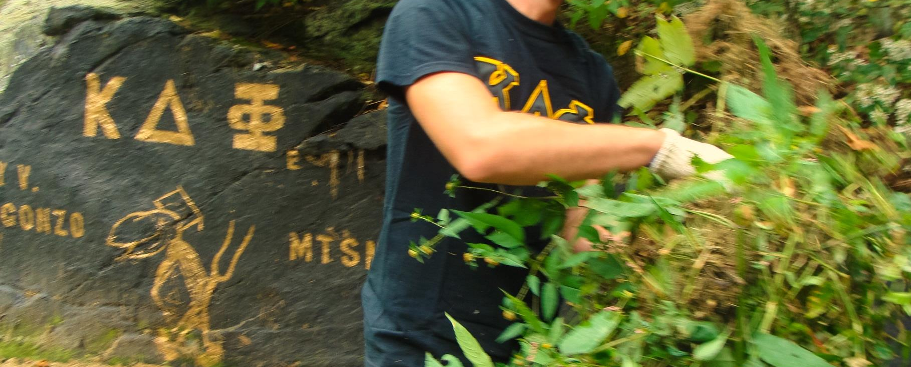
Epsilon chapter
Rhode Island College’s Chapter

Slide 17
EPSILON CHAPTER
Founded in 1928
The first fraternity organized on campus
Stresses and promotes three main areas in its program:
Education
Philanthropy
Social events

Slide 18
EPSILON CHAPTER
Restarted in Spring of 2011
Still holds to tradition
Pride ourselves on our money raised; money, time & goods donated; and social events.

Slide 19
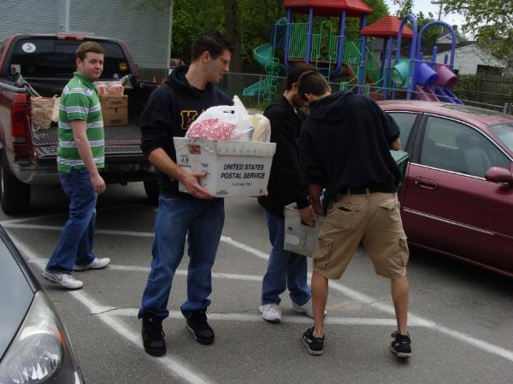
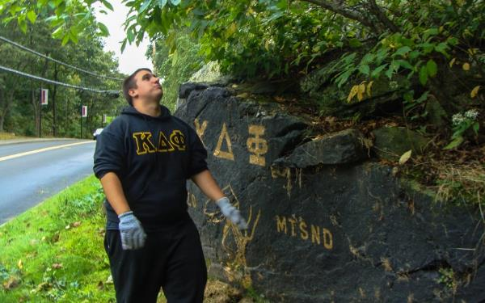
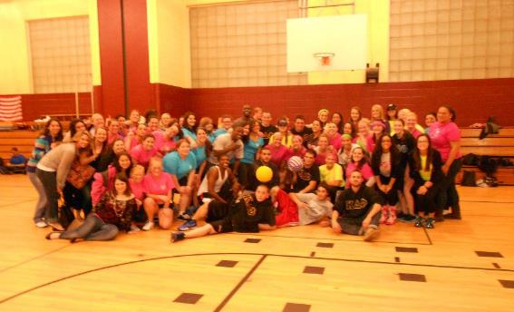
EPSILON’S CHARITY

Slide 20
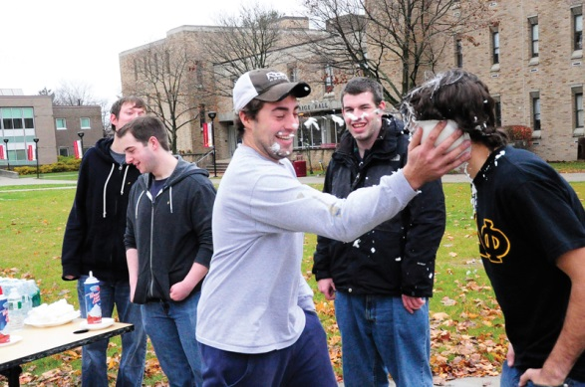
EPSILON’S FUNDRAISING

Slide 21
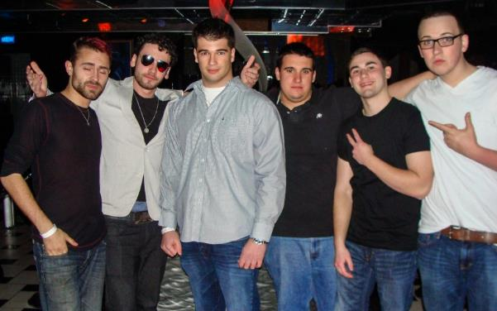
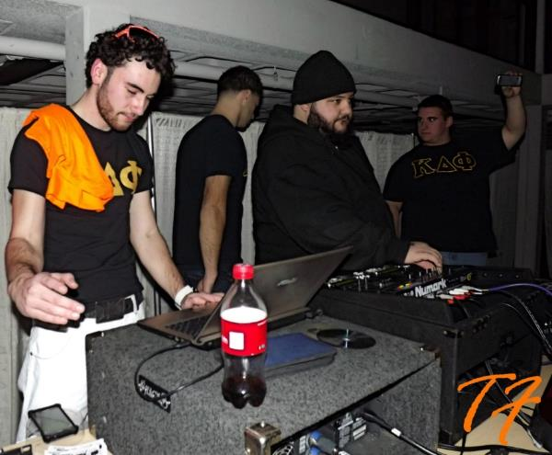
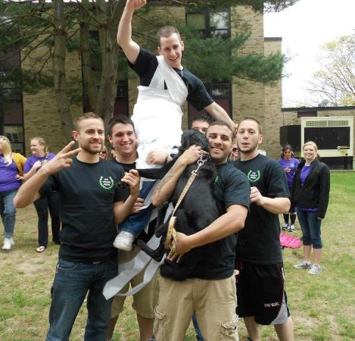
EPSILON’S SOCIAL EVENTS

Slide 22
REQUIREMENTS
Attend rush events
If given a bid, complete pledge process
Spring dues:
$185 National Dues
$25 Chapter Dues
Once a member, chapter must maintain a 2.50 GPA

