Slide 1
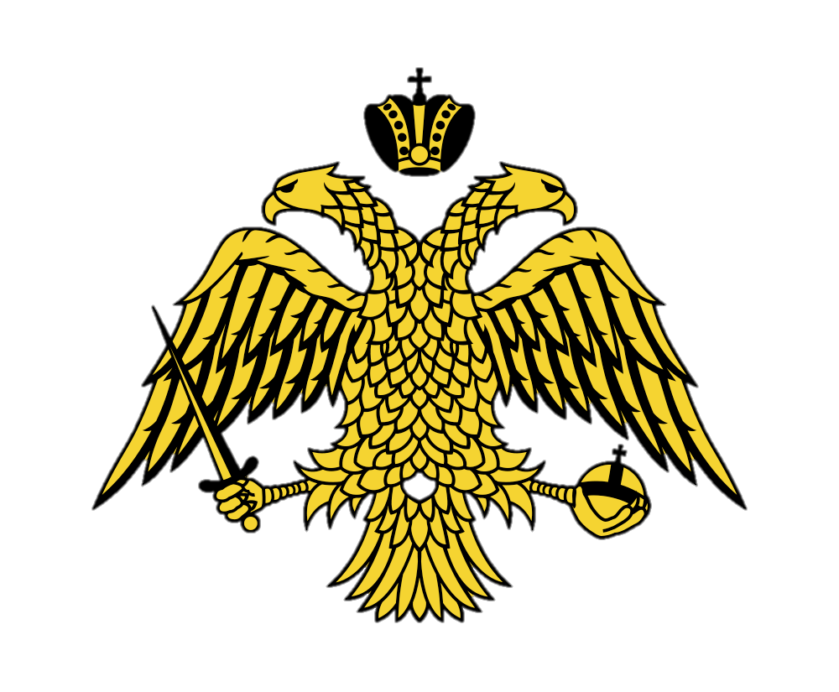
Greek Orthodox Vestments

Slide 2
Sticharion
Also known as a robe
Similar to alb
Worn by clergy and acolytes
Derived from baptism robe
Symbolizes cleanliness
Usually white for priests and bishops, unless during particular celebrations
Undermost layer for priests/bishops

Slide 3
Orarion
Also called a belt, sash, or stole
Worn by deacons and acolytes
Deacon’s is larger and is wrapped around body
Except while giving Communion
Illustrates that they are to be servers like the angels to God

Slide 4
Epitrachilion
“over the neck”
Also called a stole
Worn by priests and bishops
Worn whenever serving as a priest
Symbolizes the rope that Jesus was dragged from

Slide 5
Epimanikia
Cuffs worn by clergymen
Vary according to rank
Resemble Roman maniple

Slide 6
Phelonion
Similar to a cape
Worn by priests
Symbolizes the robe Christ wore during His Passion
Ribbons symbolize flowing blood

Slide 7
Epigonation
Originated from “knee-protectors”
Represents spiritual sword as a soldier of Christ

Slide 8
Sakkos
“garment of humility”
Worn by bishops
Resembles attire of Byzantine emperors

Slide 9
Omophorion
“shoulder covering”
Worn by bishops
Originally made of sheep wool for warmth
Also symbolizes the parable in which the lost sheep was laid on the good shepherd’s shoulders

Slide 10
Mitre
Can be considered a crown
Worn by bishops
Resembles the crowns worn by Byzantine emperors

Slide 11
Mantle
Outermost cape for bishops
Originally to keep warm
Symbolizes passing down of authority, as Elijah passed down to Elishah

Slide 12
Acolyte Vestments

Slide 13
Deacons’ Vestments

Slide 14
Priests’ Vestments

Slide 15
Bishops’ Vestments

